Slide 1
Understanding and using the kit: Training of trainers for facilitators Module 3: Building Adolescent Circles
The Adolescent Development and Participation Section
Priya Marwah, Adolescents in Emergencies and Peacebuilding Specialist
Ellen Fransen, Programme Assistant
Juliet Young, Consultant

Slide 2
3.1 Forming strong, inclusive Adolescent Circles
Notes:
Cover slide for this first section of the webinar.

Slide 3
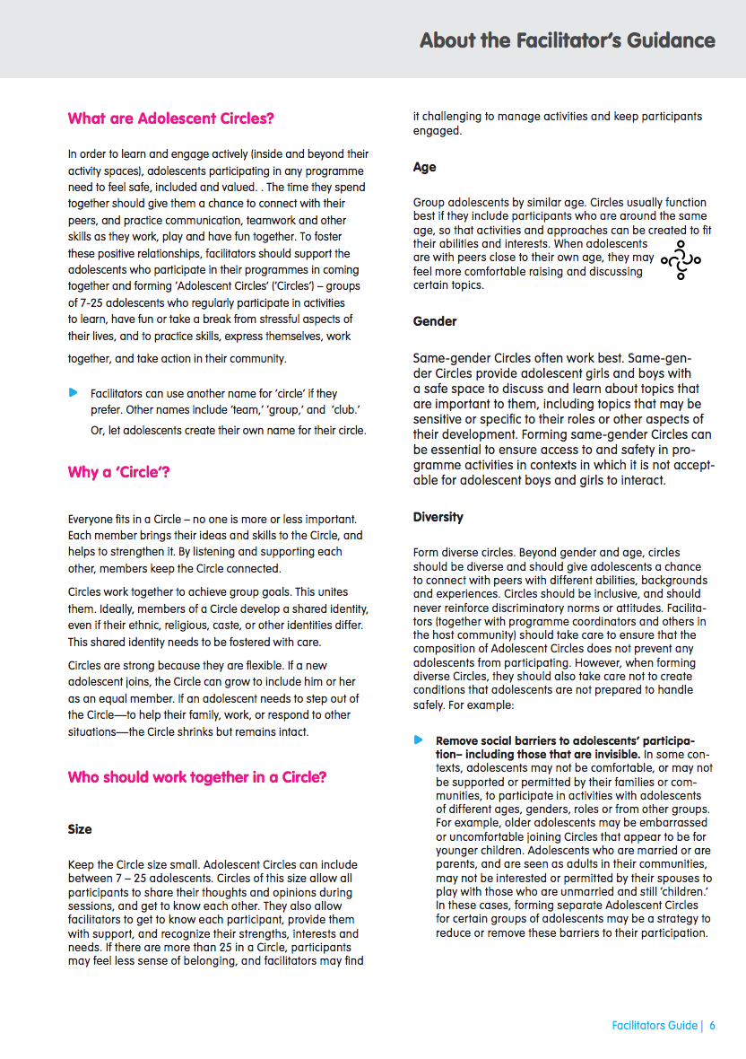
What are “Adolescent Circles”?
A basic approach recommended in the Adolescent Kit for Expression and Innovation is to support adolescents in forming and working together as a ’circle.’
An Adolescent Circle is a group of adolescents who gather to learn, practice skills, express themselves, build a team, and take action in their community.
Working as a circle creates opportunities for adolescents, especially those living in crisis situations, to have fun, recover from difficult experiences, explore, be creative, make friends, and work together on interesting projects.
Notes:
Notes for trainer:
Read this slide aloud, or ask a workshop participant to do so.
Ref: Facilitator’s Guide, What are Adolescent Circles?

Slide 4
Why a ‘circle’”? (continued)
Everyone fits in a circle - no one is more or less important. Each member brings their ideas and skills to the circle, and helps to strengthen it. By listening and supporting each other, they keep the circle connected.
Circles work together to achieve group goals. This unites participants. Ideally, they develop a shared identity as members of their circle, even if their ethnic, religious, caste, or other identities differ. This shared identity needs to be fostered with care.
Circles are strong because they are flexible. If a member needs to step out of the circle—to help their family, work, or respond to other situations—the circle shrinks but remains intact.
Include all
adolescents
Notes:
Notes for trainer:
This slide presents the explanation of why the term ‘circle’ was chosen for the Adolescent Kit.
Participants can compare their answers to the explanation in this slide. However, remember that there is no ‘correct’ answer to the question, “Why a ‘circle’?”– workshop participants’ own associations with the word circle are as ‘valid’ as the explanation provided and should be treated as such.
Ref: Facilitators’ Guidance: Adolescent Circles

Slide 5
Discussion
Why a ‘circle’?
What does a circle represent to you?
What does a circle represent in our cultural context?
In what ways could a ‘circle’ represent a safe, inclusive group of people?
Should we use the term “circle,” or another term, for groups of adolescents that we will organize in our programme?
?
Notes:
Notes for trainer:
Optional: Draw a circle on a piece of flip chart paper or a marker board.
Ask participants to respond to the questions and discuss their answers.
Depending on plans for the workshop participants’ programme, use this step as an opportunity for participants, if they prefer to use another term, to suggest an alternative for ‘circle’.
Ref: Programme Coordinators Guidance, Investigate Adolescents’ Situation, Tool: Exploring challenges and opportunities for adolescents

Slide 6
Forming a strong circle: Recommendations
Size: Seven to 25 adolescents per circle.
Age: Group adolescents of similar ages together.
Gender: Separate groups for girls and boys often work well.
Diversity:
Whenever possible, include adolescents from different backgrounds in the same circle to build connections.
Include adolescents with and without disabilities in the same circle. Never form ‘disabilities-only’ circles.
Support: One or two facilitators per circle.
Action planning
How many adolescents will we include in each circle?
How will we group adolescents with those of similar or different ages, genders and other identities into circles?
What planning steps and choices do we need to take in order to have an optimal ratio of facilitators to adolescents?
Notes:
Notes for trainer:
Read this slide aloud, or ask a workshop participant to do so.
Use this opportunity to discuss whether the recommended circle size, circle composition (age, gender and other diversity factors) and ratio of facilitators to adolescents will be feasible in this programming context, and strategies they can use to try to follow these guidelines.
Ref: Facilitators’ Guidance: Adolescent Circles

Slide 7
Discussion:
How will we include all adolescents in circles in our programme?
What is the difference between reaching and including adolescents?
Finish this sentence:
“When an adolescent is truly included in a programme, he or she…”
Include all
adolescents
Notes:
Notes for trainer:
Remind workshop participants of the importance of diversity with respect to including adolescents of different abilities, and those from different ethnic, religious, or other identity groups in the same circles.
Use this step as an opportunity for workshop participants to discuss challenges they face in ensuring that all adolescents feel included in activities, and to begin to brainstorm activities and other processes they can use to ensure that all adolescents are included.

Slide 8
3.2 Using Group Rules to build strong, safe circles
Notes:
Cover slide for this first section of the webinar.

Slide 9
Discussion:
(These questions will be especially relevant for anyone who has worked as a teacher or facilitator directly with a group of adolescents, on this or any other programme.)
When each of us have worked with a group of adolescents, what are some signs that we have seen that they are starting to work well together?
What are some proactive strategies we each use to try to help adolescents build a sense of teamwork?
Notes:
Notes for trainer:
Workshop participants can discuss these questions in plenary.
Encourage workshop participants to remember that telling adolescents to get along and work well is not nearly as useful as allowing them to experience and practice working together.
Recommendation: Keep notes of workshop participants’ answers to the second question, as these may be useful references for future discussions about new strategies they can try.

Slide 10
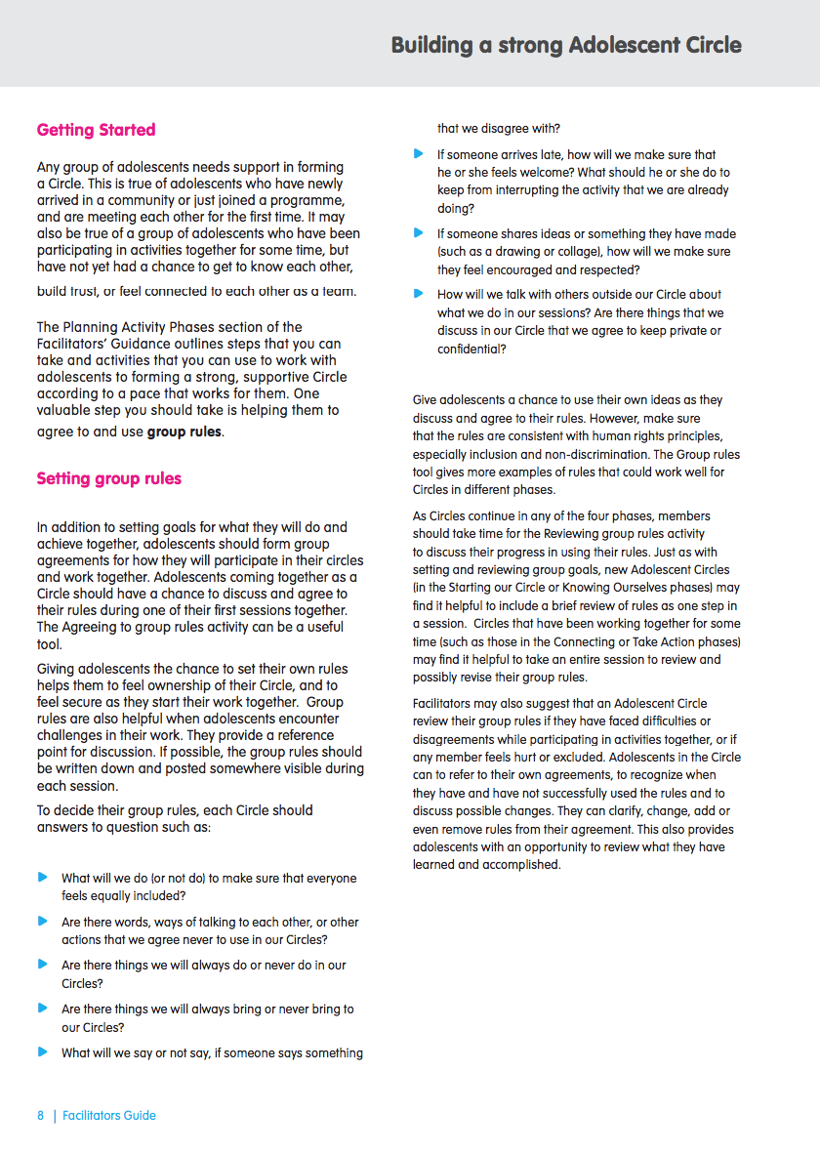
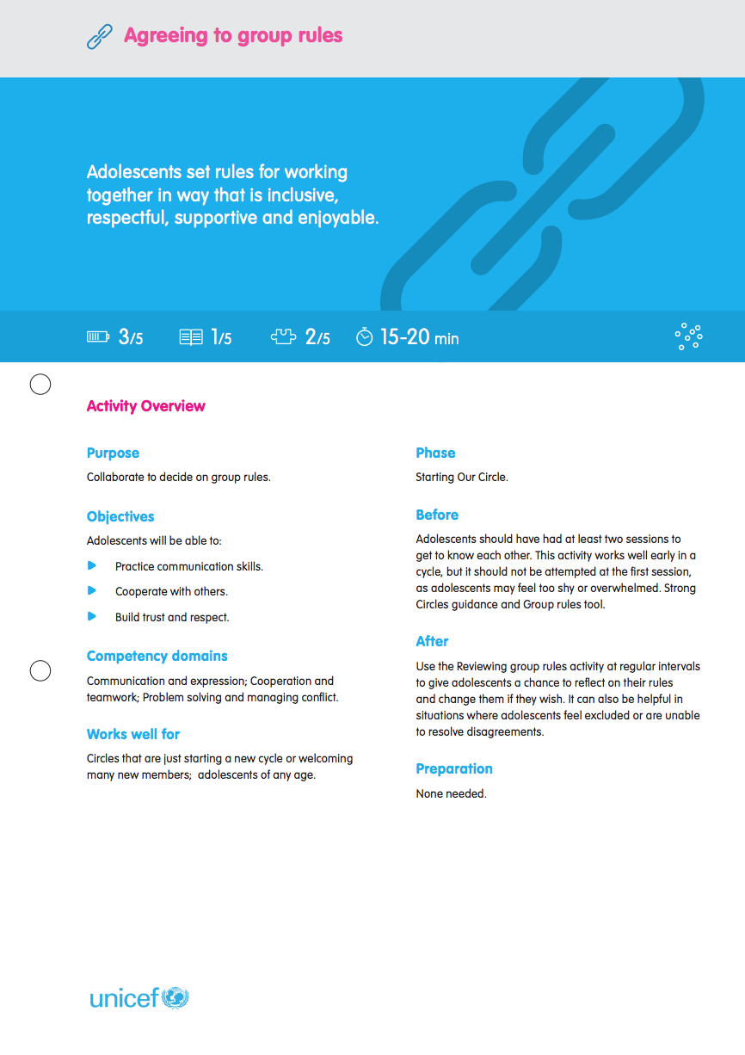
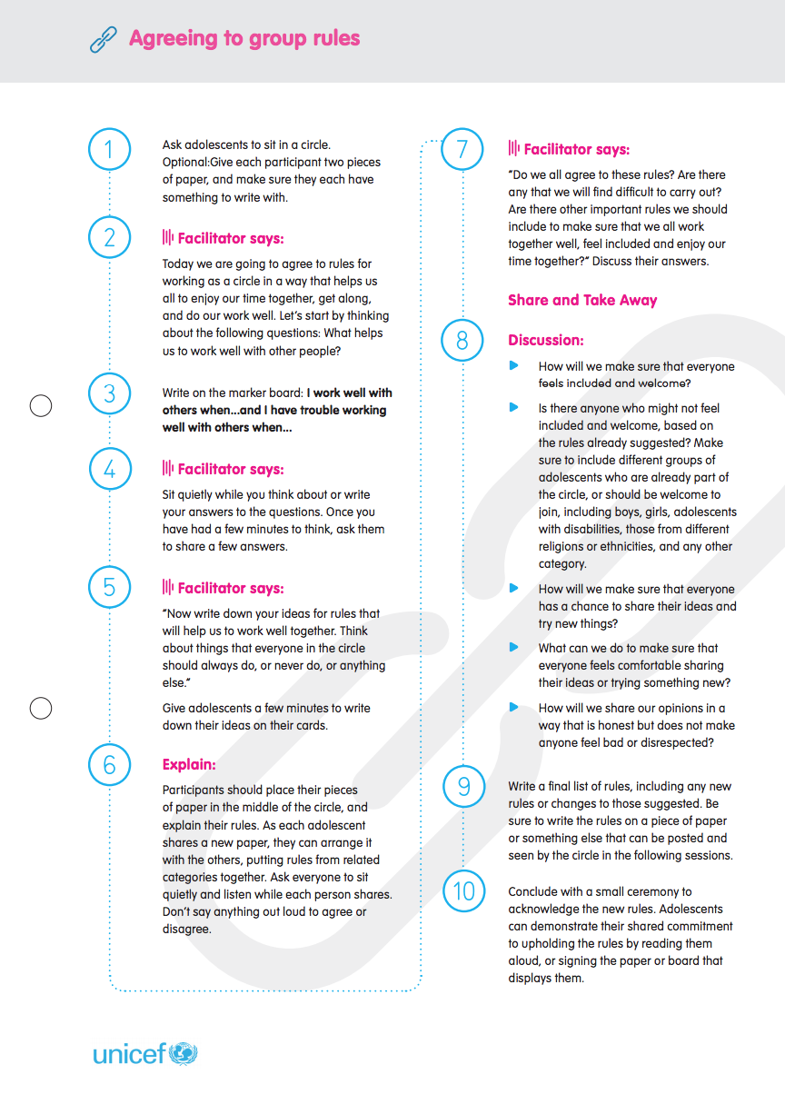
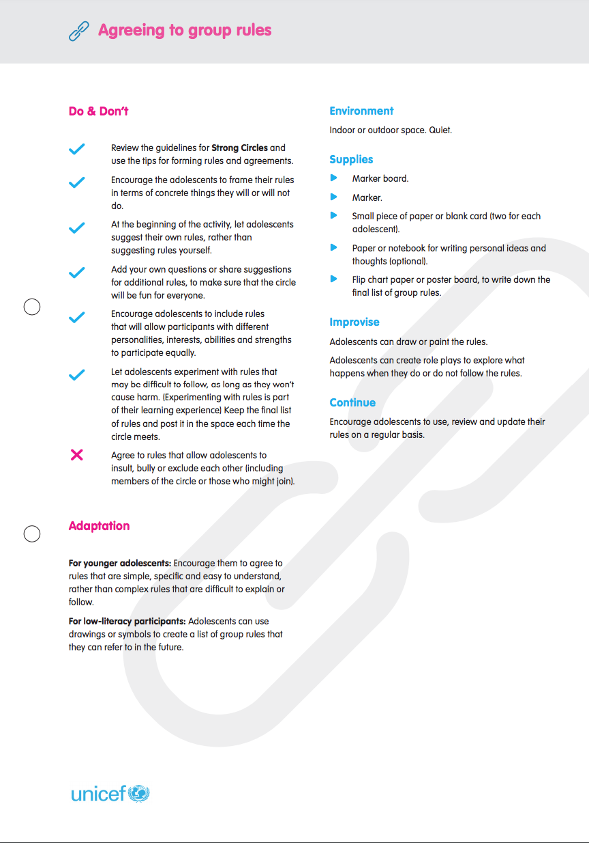
Agreeing to Group Rules
Clarification: group rules vs. group goals
Group rules focus on how they will spend their time together and work together.
Group goals focus on what adolescents want to achieve together.
Notes:
Note for trainer:
Use this slide for a brief clarification of the difference between these two processes. Both are recommended for Adolescent Circles, but they serve different purposes.
Ref: Facilitator’s Guide, Building a Strong Adolescent Circle

Slide 11
Notes:
Notes for trainer:
Use this slide to refer workshop participants to the “Agreeing to group rules” activity guide, which is included in the Activity Box.
Ref: Activity Guide: Agreeing to Group Rules

Slide 12
Notes:
Notes for trainer:
Use the steps listed this slide to guide participants through a process of developing and agreeing to their own group rules, as an experiential learning process.
Ref: Activity Guide: Agreeing to Group Rules

Slide 13
Discussion:
(These questions will be especially relevant for anyone who has worked as a teacher or facilitator directly with a group of adolescents, on this or any other programme.)
Why should adolescents form their own group rules?
Is this something you already do? How do you guide them through the process?
What do you when adolescents suggest a rule that you think might not be helpful?
How do adolescents use and enact their own rules?
Notes:
Notes for trainer:
Use the questions on this slide to review the group rules that workshop participants have outlined, and to revise and improve them if the participants feel this would be helpful.
Once participants have agreed to their group rules, ask:
Why should adolescents form their own group rules? (Possible points to discuss include: When adolescents determine their own rules, this gives them a sense of ownership and commitment to those rules. They don’t feel that the rules are imposed by adults.)
Is this something you already do? How do you guide them through the process?
What do you when adolescents suggest a rule that you think might not be helpful?
How do adolescents use and enact their own rules?
Ref: Activity Guide: Agreeing to Group Rules

Slide 14
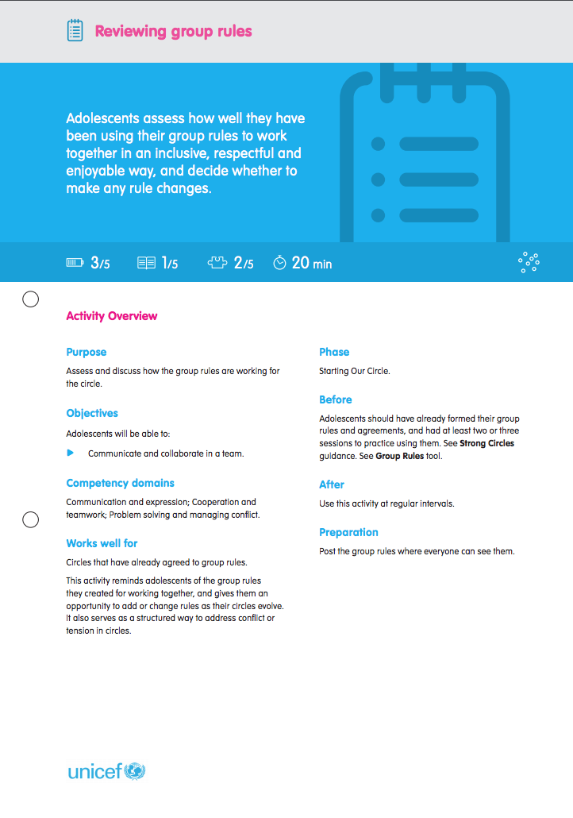
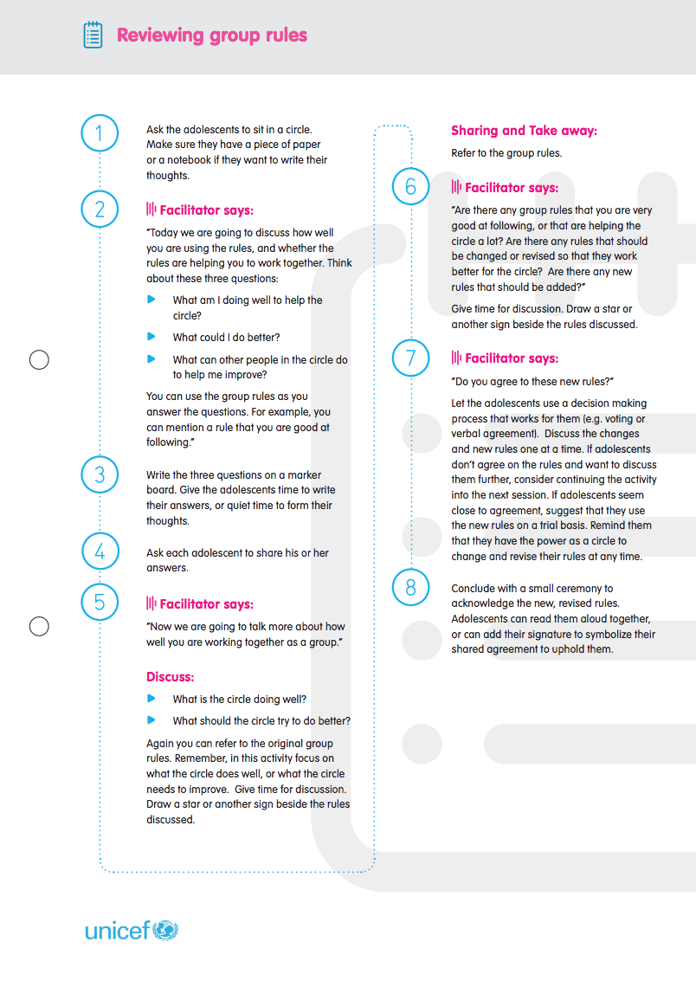
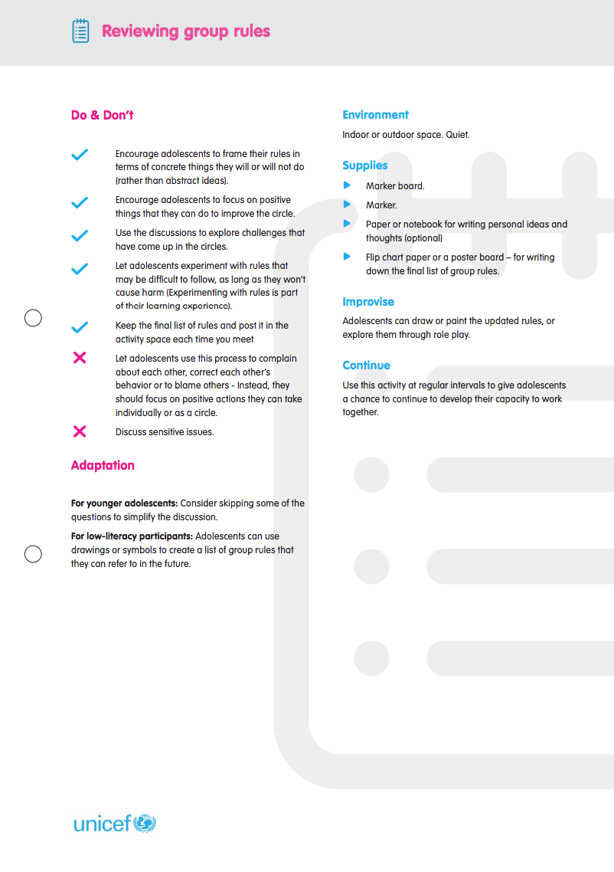
Looking ahead: Reviewing Group Rules
A key recommendation is for each adolescent circle to periodically review, discuss and (perhaps) revise their own rules.
Giving adolescents a chance to review their group rules puts them in the lead to build their own strong Circle.
This is a proactive strategy – it helps adolescents learn how to manage conflicts and puts them in the lead.
Notes:
Notes for trainer:
Use this slide to refer workshop participants to the “Reviewing group rules” activity guide, which is included in the Activity Box.
Ref: Activity guide: Reviewing group rules
Ref: Facilitators’ Guidance: Keeping circles safe and strong tool. Review steps that facilitators can take, building on the Agreeing to group rules activity, to support adolescents in preventing and transforming conflicts within their Circles when they arise.

Slide 15
3.3 Support and structure for Adolescent Circles: Eight Session Steps
Notes:
Cover slide for this first section of the webinar.

Slide 16
Discussion:
(These questions will be especially relevant for anyone who has worked as a teacher or facilitator directly with a group of adolescents, on this or any other programme.)
As a facilitator, is this already part of how you plan sessions? What steps do you include in each session?
If so, what benefit does this structure have for adolescents?
Recommendation:
Plan activity sessions for adolescent circles that include with consistent, predictable steps.
Provide structure and support
Notes:
Notes for trainer:
Lead a discussion with participants focusing on the two questions:
As a facilitator, is this already part of how you plan sessions? What steps do you include in each session?
If so, what benefit does this structure have for adolescents?
Ref: Facilitators’ Guidance: Planning Sessions
Ref: Facilitators’ Guidance: Planning Sessions, Session Step Planning Tool

Slide 17
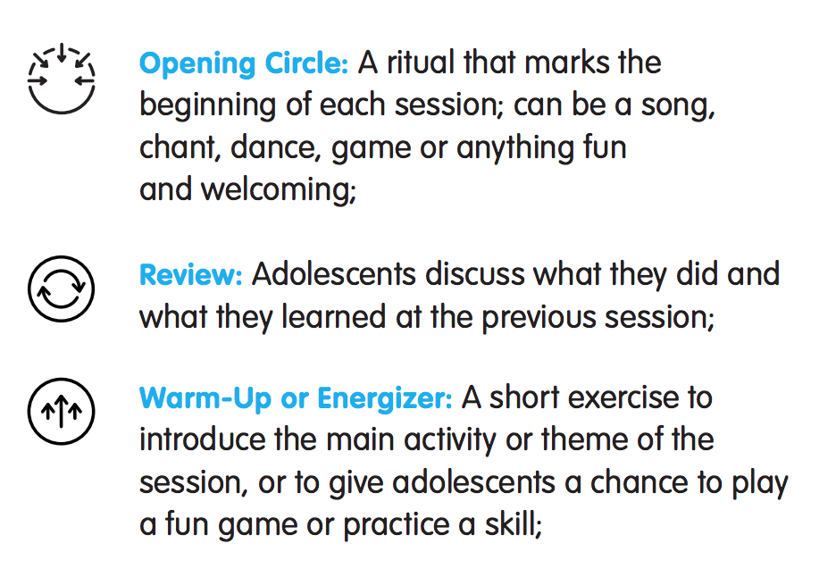
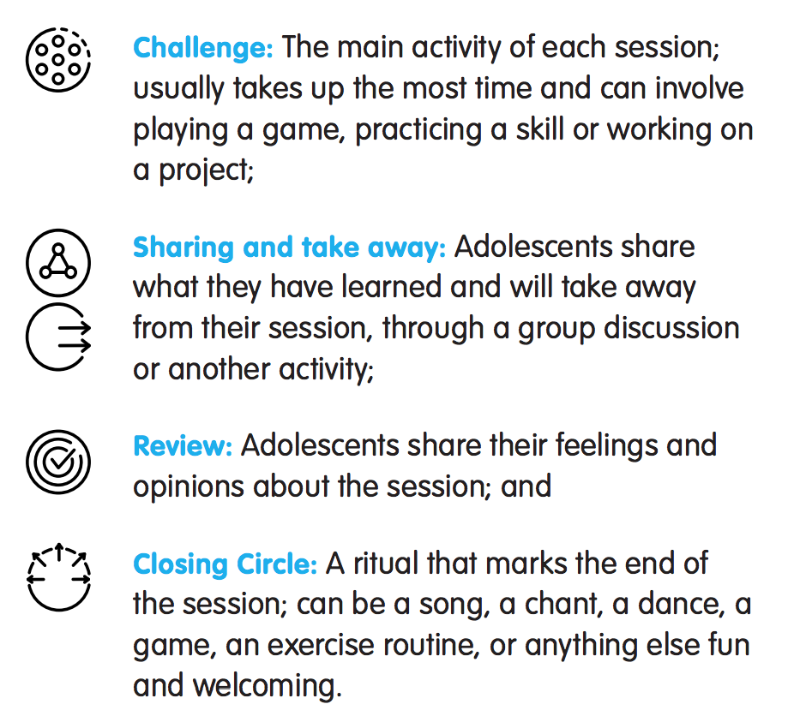
Session steps:
….Create structure, routine and predictability to support adolescents
….Give facilitators a chance to monitor adolescents’ progress and listen to their perspectives and experiences
…Should create a comfortable flow, but should not be used too rigidly.
Notes:
Notes for trainer:
Review the overall sequence and flow of the nine steps.
Ref: Facilitators’ Guidance: Planning Sessions
Ref: Facilitators’ Guidance: Planning Sessions, Session Step Planning Tool

Slide 18
Notes:
Notes for trainers:
Highlight the purpose of each step. (This slide provides detailed explanations of Steps 1-5 from the Facilitators’ Guidance)
Ref: Facilitators’ Guidance: Planning Sessions, and the Session Step Planning Tool

Slide 19
Notes:
Notes for trainers:
Highlight the purpose of each step. (This slide provides detailed explanations of steps 5-9 from the Facilitators’ Guidance)
Ref: Facilitators’ Guidance: Planning Sessions and refer to the Session Step Planning Tool

Slide 20
Discussion:
Which steps do you already include when planning sessions for adolescents?
Which of the ‘Ten Key Approaches’ do you see reflected in this practice of consistently planning sessions using these eight steps?
Reminder: Structure does not mean lecture. Sessions can include periods of time for adolescents to practice or work on projects individually, or work together on group projects without direct guidance from the facilitator, especially in the challenge step.
Notes:
Notes for trainer:
Discuss in plenary. Some points to discuss:
By using a predictable structure we are using key the approach to provide structure, routine and support.
Predictability also helps adolescents to take the lead. If they know what to expect, they can feel more confident stepping in and sharing their own ideas.
Specific session steps also help facilitators to using key the approach to listen to adolescents.
Ref: Activity Guide: Practice and project time

Slide 21
3.4 Connect adolescents with support
Notes:
Cover slide for this first section of the webinar.

Slide 22
Group work/action planning:
What support do adolescents in our programming context need?
Food, water and essential supplies
Health care services
Education, learning and information services
Protection and legal support
Arts, recreation and sports
Clubs and organizations
With respect to each of the above categories of service or support…
What are the needs of adolescents in our programme contexts?
What services or support are available for them? (Be as specific as possible!)
Provide structure and support
Build connections
Notes:
Notes for trainer:
Divide participants into six small groups. Each group should focus on one of the categories of service and support.
Encourage participants to answer the questions with as much specific information as possible, based on their knowledge of adolescents’ needs, and also of the support services available to them.

Slide 23
Group work/action planning:
What support do adolescents in our programming context need?
Food, water and essential supplies
Health care services
Education, learning and information services
Protection and legal support
Arts, recreation and sports
Clubs and organizations
With respect to each of the above categories of service or support…
What are the needs of adolescents in our programme contexts?
What services or support are available for them? (Be as specific as possible!)
Provide structure and support
Build connections
Notes:
Notes for trainer:
Participants should review their answers to the first question against the list of possible services, support and organizations in the ‘Connect Adolescents to Support’ tool, page 2, and consider whether there are types of services, support and organizations that they did not include in their list.
Note: The list on the ‘Connect Adolescents to Support’ tool is not necessarily comprehensive or correct and relevant for adolescents in all contexts.
Workshop participants may have included important and valid examples of needs or opportunities for adolescents in their programme context that are not listed on the tool, and that they should consider when preparing to connect adolescents with support.
Workshop participants should, however, consider examples listed on the tool that they did not think of as they brainstormed in small groups.
Use this discussion to dispel myths about adolescents’ sexual and reproductive health needs, and rights. Remind participants that many adolescents in all contexts are sexually active and have a right to sexual and reproductive health services.
Use this discussion to dispel myths that violence, including gender-based violence, and or other risks, are not present in the programme context, if such myths arise. Remind participants that adolescents in all contexts, especially humanitarian contexts, face risks with respect to violence, and need services and support to protect them, as well as to support those who are victims of violence.
Ref: Programme Coordinators Guide: Connect Adolescents to Support; Connect adolescents to support tool

Slide 24
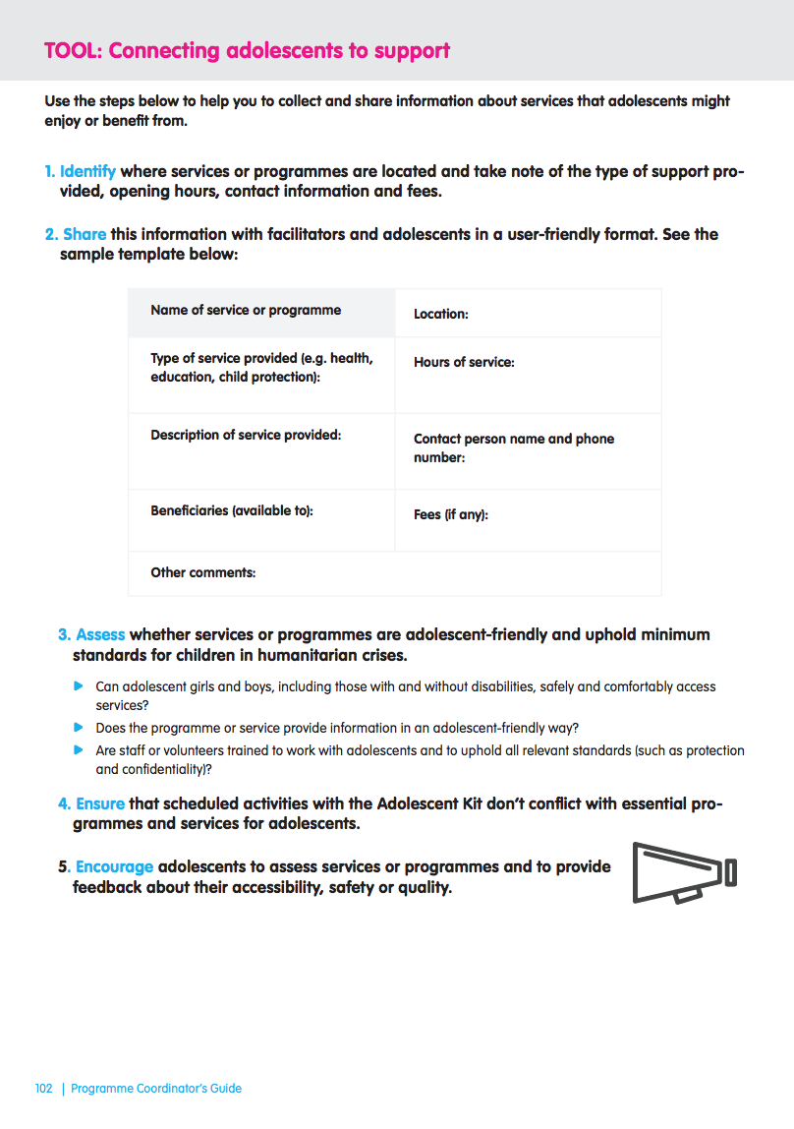
Group work/planning discussion:
What (further) information do adolescents in our programming context need to access these services?
Food, water and essential supplies
Health care services
Education, learning and information services
Protection and legal support
Arts, recreation and sports
Clubs and organizations
Notes:
Notes for trainers:
Workshop participants should continue to work in the same small groups in which they were working in the first step of this module, using a copy of the template on page 1 of the Connecting adolescents to support tool.
When the activity is complete, consolidate the information, and create a plan for facilitators to use and to share with adolescents with whom they work.
Ref: Programme Coordinators Guide: Connect Adolescents to Support; Connect adolescents to support tool

Slide 25
Action planning:
How will we find and add any information about services, support or organizations for adolescents that we do not already have?
How will we share this information with adolescents who participate in our programme?
Notes:
Notes for trainers:
Discuss in plenary. Keep and include workshop participants’ action plans in broader roll-out and implementation planning processes.
Possibilities to consider:
Post information on a bulletin board or poster in your activity space.
Keep a resource book of information available for both facilitators and adolescents so they can find the services, support or organizations they need.
Support adolescents in researching services, support and organizations in their community. The Recognize resources activity is one way to do this.
The Connecting adolescents with support tool includes a template for sharing information with facilitators and adolescents that participants could consider adapting and using in their programme.

Slide 26
Thank you!

